Slide 1
Additional Topics
Here we discuss
Using residual plots to check model assumptions
Using dummy variables
Chap 14-<number>

Slide 2
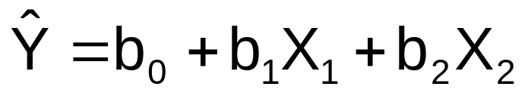
Residuals in Multiple Regression
Two variable model
Y
Sample observation
Y_{i}
Residual = e_{i} = (Y_{i} – Y_{i})
<
<
Y_{i}
x_{2i}
X₂
x_{1i}
The best fit equation is found by minimizing the sum of squared errors, Σe²
X₁
Chap 14-<number>

Slide 3
Multiple Regression Assumptions
Errors (residuals) from the regression model:
<
e_{i} = (Y_{i} – Y_{i})
Assumptions:
The errors are normally distributed
Errors have a constant variance
The model errors are independent
Chap 14-<number>

Slide 4
Residual Plots Used in Multiple Regression
These residual plots are used in multiple regression:
  Residuals vs. Y_{i}
  Residuals vs. X_{1i}
  Residuals vs. X_{2i}
  Residuals vs. time (if time series data)
<
Use the residual plots to check for violations of regression assumptions
Chap 14-<number>

Slide 5
Using Dummy Variables
A dummy variable is a categorical independent variable with two levels:
  yes or no, on or off, male or female
  coded as 0 or 1
Assumes the slopes associated with numerical independent variables do not change with the value for the categorical variable
If more than two levels, the number of dummy variables needed is (number of levels - 1)
Chap 14-<number>

Slide 6
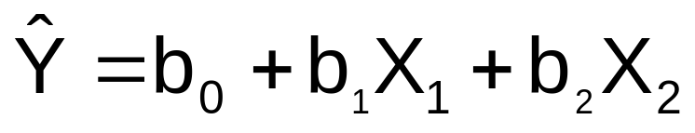

Dummy-Variable Example
(with 2 Levels)
Let:
Y = pie sales
X₁ = price
X₂ = holiday (X₂ = 1 if a holiday occurred during the week) (X₂ = 0 if there was no holiday that week)
Chap 14-<number>

Slide 7
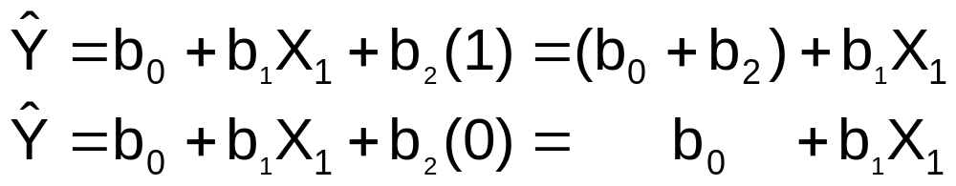
Dummy-Variable Example
(with 2 Levels)
(continued)
Holiday
No Holiday
Different intercept
Same slope
Y (sales)
If H₀: β₂ = 0 is rejected, then
“Holiday” has a significant effect on pie sales
b₀ + b₂
b₀
Holiday (X₂ = 1)
No Holiday (X₂ = 0)
X₁ (Price)
Chap 14-<number>

Slide 8
Interpreting the Dummy Variable Coefficient (with 2 Levels)
Example:
Sales: number of pies sold per week
Price: pie price in $
Holiday:
1 If a holiday occurred during the week
0 If no holiday occurred
b₂ = 15: on average, sales were 15 pies greater in weeks with a holiday than in weeks without a holiday, given the same price
Chap 14-<number>

Slide 9

Dummy-Variable Models
(more than 2 Levels)
The number of dummy variables is one less than the number of levels
Example:
Y = house price ; X₁ = square feet
If style of the house is also thought to matter:
Style = ranch, split level, colonial
Three levels, so two dummy variables are needed
Chap 14-<number>

Slide 10
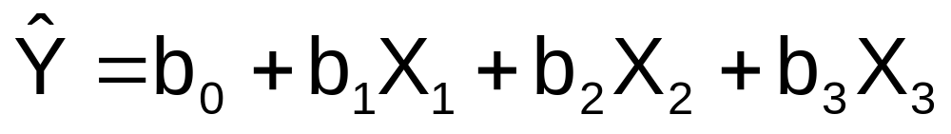
Dummy-Variable Models
(more than 2 Levels)
(continued)
Example: Let “colonial” be the default category, and let X₂ and X₃ be used for the other two categories:
Y = house price
X₁ = square feet
X₂ = 1 if ranch, 0 otherwise
X₃ = 1 if split level, 0 otherwise
The multiple regression equation is:
Chap 14-<number>

Slide 11
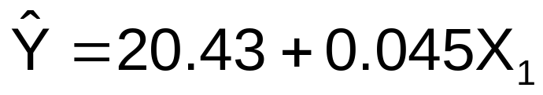
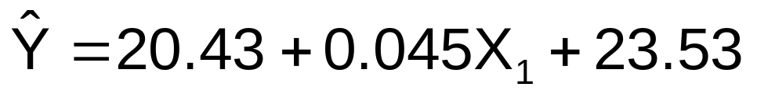
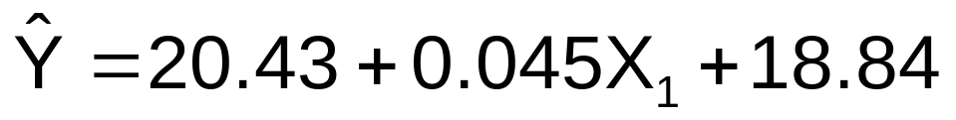
Interpreting the Dummy Variable Coefficients (with 3 Levels)
Consider the regression equation:
For a colonial: X₂ = X₃ = 0
With the same square feet, a ranch will have an estimated average price of 23.53 thousand dollars more than a colonial.
For a ranch: X₂ = 1; X₃ = 0
With the same square feet, a split-level will have an estimated average price of 18.84 thousand dollars more than a colonial.
For a split level: X₂ = 0; X₃ = 1
Chap 14-<number>

Slide 12
Examples
Page 552, # 14.39
Page 555, # 14.46
Pages 552-553, # 14.40
Chap 14-<number>

